Slide 1
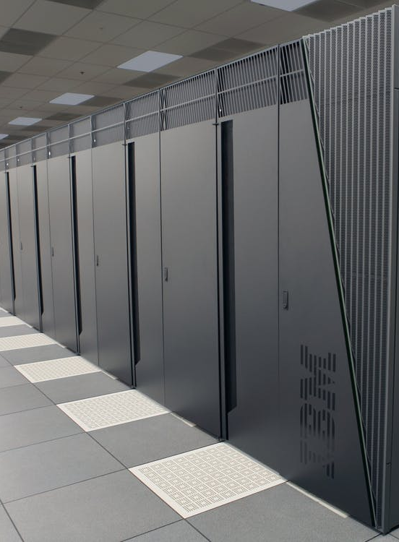
Pros & Cons
Cloud Computing

Slide 2
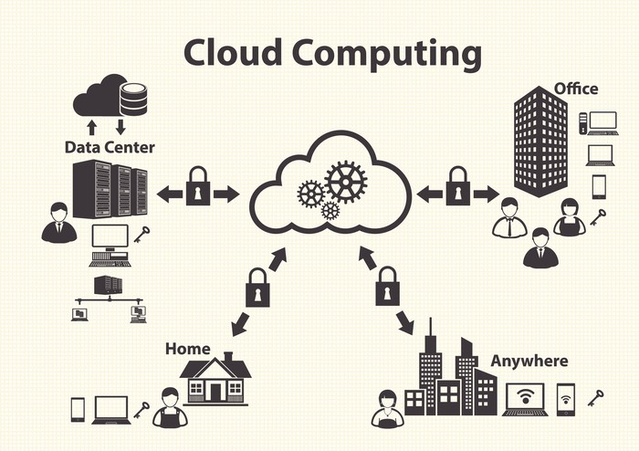
What is “Cloud Computing”?
Notes:
First of all!!!

Slide 3
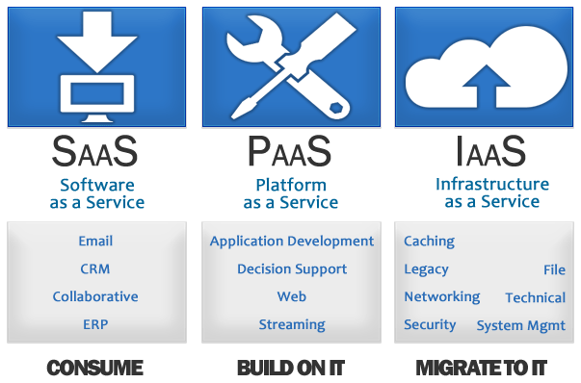
What is “Cloud Computing”?
HOST
CONSUME
BUILD
HOST
Notes:
SAAS: Facebook, paypal, Twitter, Zendesk, Google Docs, Amazon, YouTube, Twitch, …;
PAAS: Heroku (deployment), AWS SES, AWS Lambda, AWS Element (video conversion, streaming, …);
IAAS: EC2, DigitalOcean, VMWare, …

Slide 4
Facts: 1. What are the Pros?
…of the Cloud Computing.

Slide 5
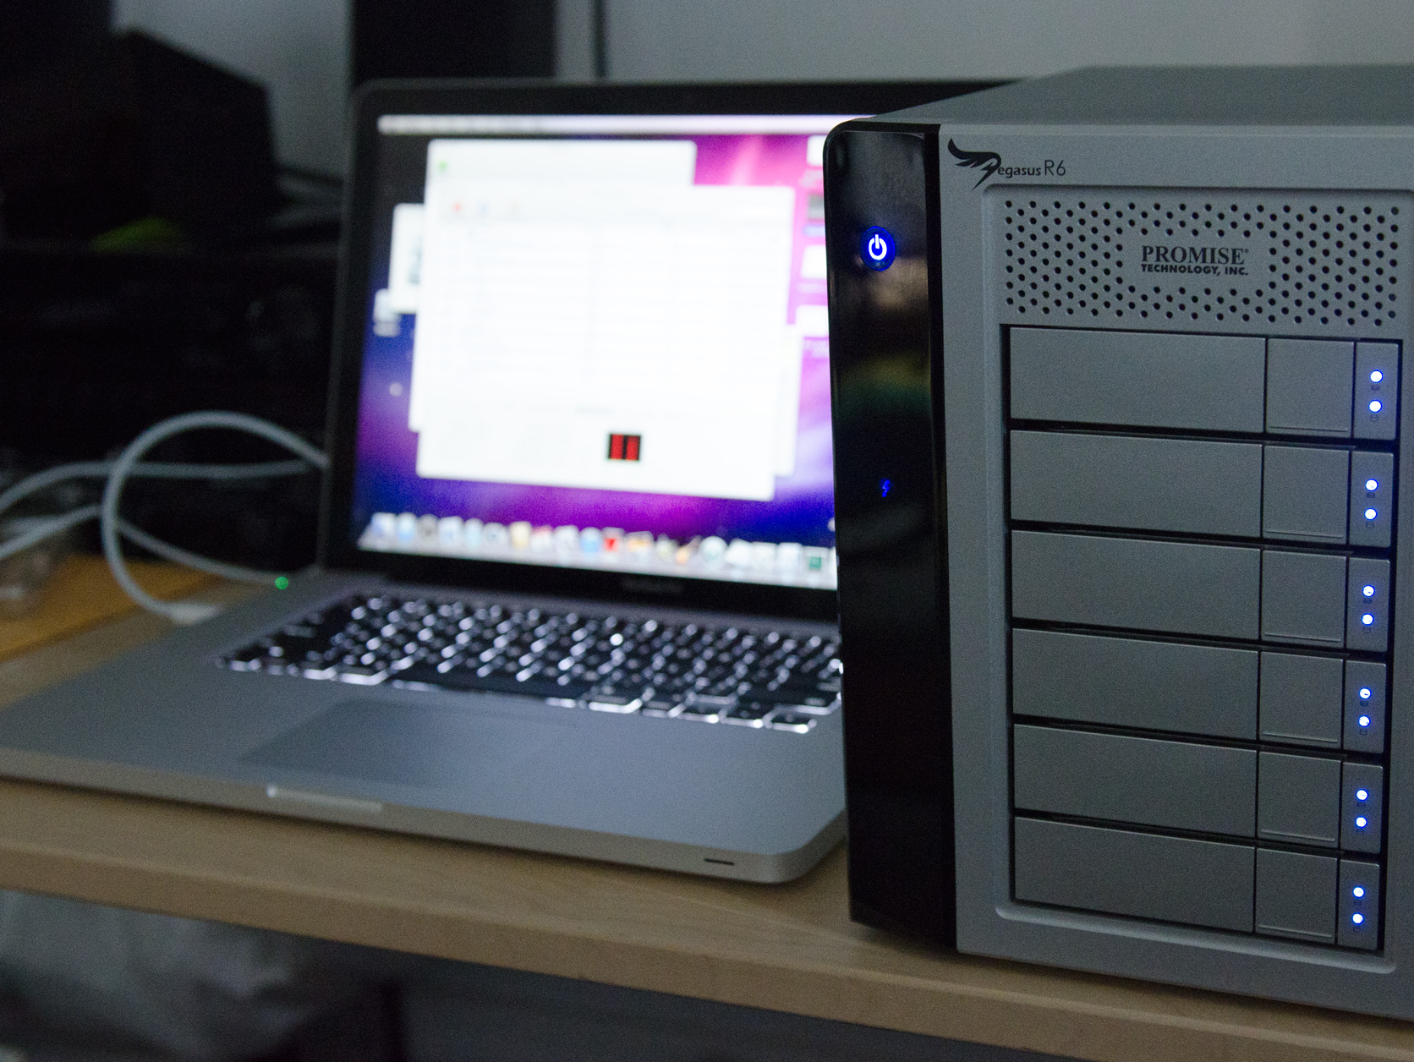

Less Hardware, More Storage
Writing and publishing systems, cloud storage providers, …
Notes:
Google docs, overleaf, google drive, ….

Slide 6
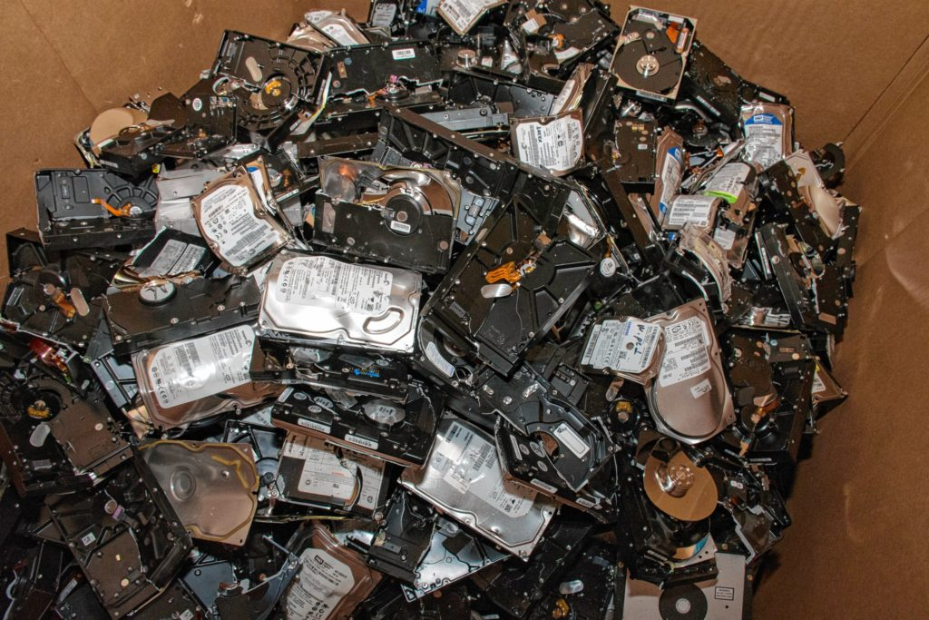
Less Hardware, More Storage
Writing and publishing systems, cloud storage providers, …
Notes:
It requires a lot of energy to dispose them! …but are very durable!

Slide 7
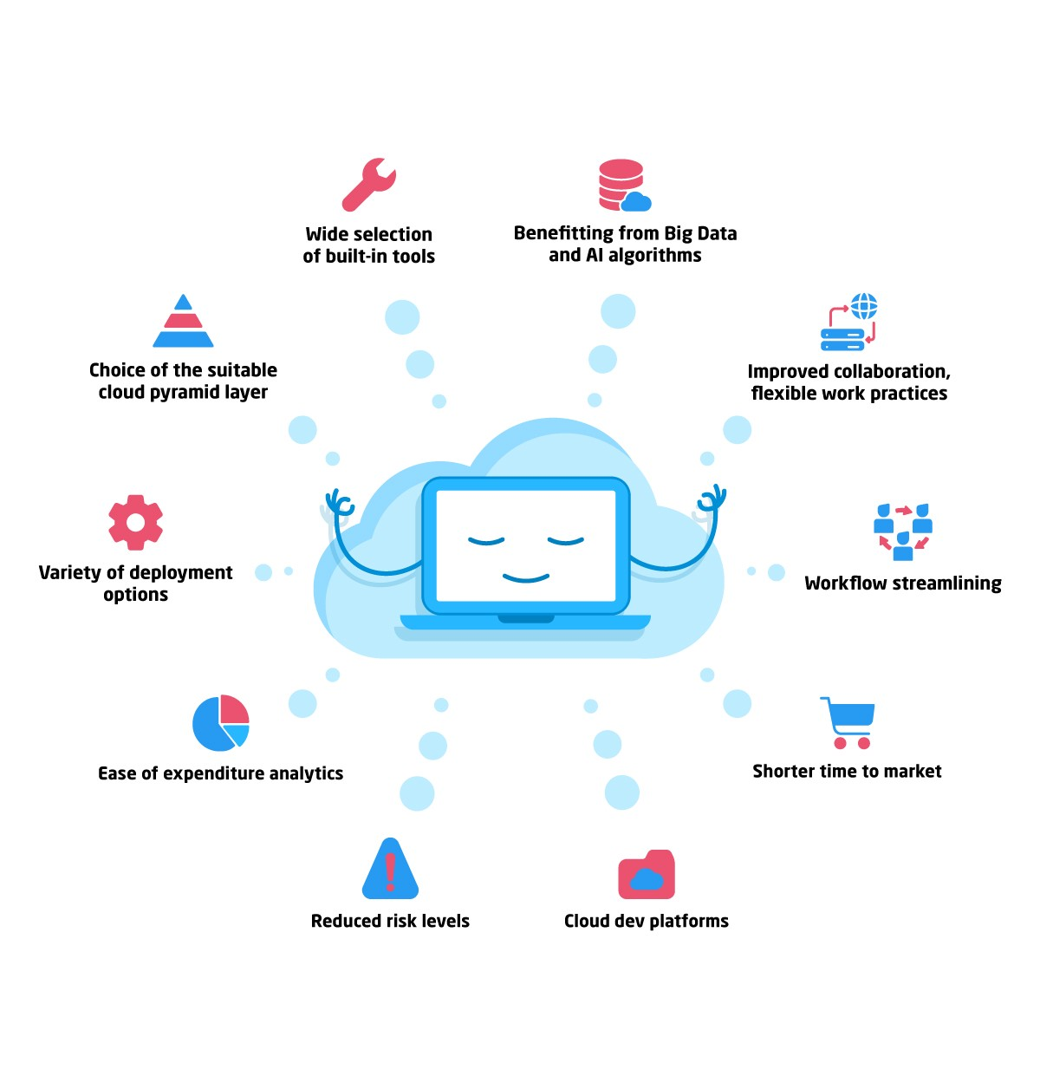
10 ways to improve your productivity!
Anything, Anywhere, Anytime
Productivity!
& don’t maintain anything, no hardware required.
Notes:
Lowercost of ownership, less maintainability => security

Slide 8
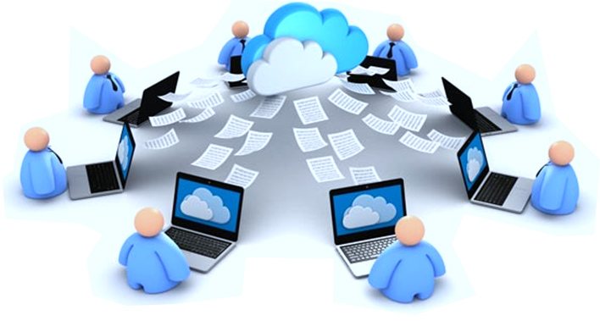
Anything, Anywhere, Anytime
…with Anyone!

Slide 9
Facts: 2. What are the Cons?
…of the Cloud Computing.
Notes:
the biggest question you hear is “what about security?”

Slide 10

Internet Connectivity (may be required)
Most of the cloud applications have no offline support (at the moment).

Slide 11

No Control
Privacy concerns, low support, no control, relies on trust.
Someone else is looking after your data;
Cyberattacks;
Insider threats;
Government intrusion;
Lack of standardization;
Lack of support;
There's always a risk: you never know what’s going to happen.

Slide 12
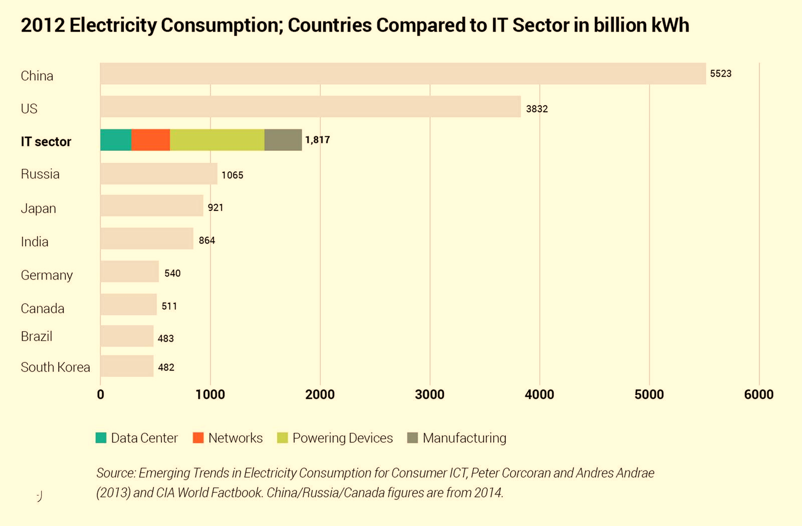
Data from: Andrae, Anders, & Corcoran, Peter M. (2013). Emerging
trends in electricity consumption for consumer ICT.
Hardware and Power are required, and have an environmental cost.
But! It may be still better.
Graph 1

Slide 13
Data from: Andrae, Anders, & Corcoran, Peter M. (2013). Emerging
trends in electricity consumption for consumer ICT.
Hardware and Power are required, and have an environmental cost.
But! It may be still better.
Graph 2
Electricity Consumption (TWh/yr) vs Growth in Core Network Traffic (including traffic within data centers), where ~70% of total traffic is between data centers.

Slide 14
Pros Summary
Collaborative work made easier;
Productivity, work anywhere, anytime;
Maximal availability;
Data safe from hardware issues;
Acceptable privacy for non-enterprise users;
Less hardware;
More power at low cost;
More storage

Slide 15
Cons Summary
Internet connectivity required;
No control, the user is totally powerless (e.g.: Technical Issues);
Security and privacy concerns;
Trust based solutions;
Power & hardware have a cost on the environment.

Slide 16
What are your thoughts?
Sharing time!
Is the cloud computing a good or a bad thing?

Slide 17
Sources
Emerging trends in electricity consumption for consumer ICT, 2013, ARAN (Access to Research at NUI Galway).
10 ways to improve your productivity! 2015, strategiccfo.com.
Cloud Computing: The Good, The Bad, & The Ugly 2016, strategiccfo.com.
8 Reasons to Fear Cloud Computing 2016, strategiccfo.com.

